Slide 1
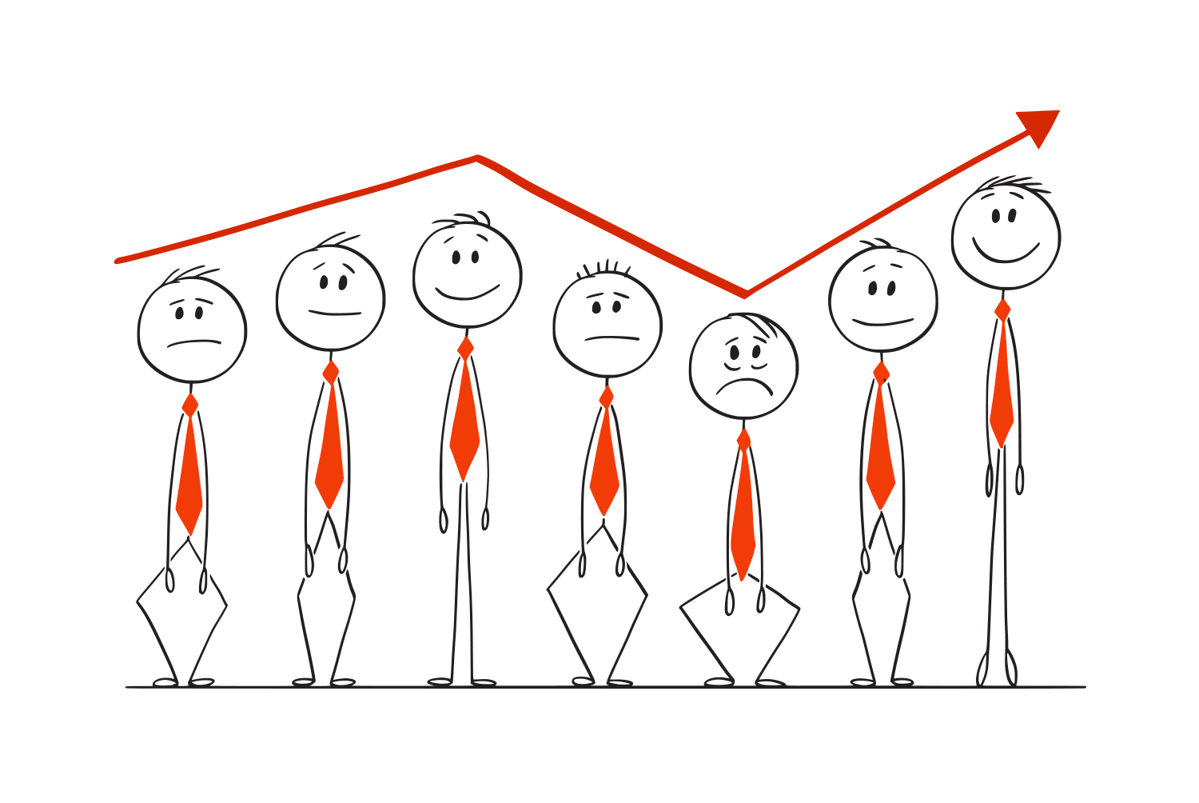
GROUP-1: Twitter sentiment analysis

Slide 2

WHAt is the project about?
The project addresses the problem of sentiment analysis in on the given dataset of users for US Airlines; that is classifying tweets according to the sentiment expressed in them:
Positive
Negative
Neutral.
This project of analysing sentiments of tweets comes under the domain of “Pattern Classification” ,“Data Mining” and “Natural Language Processing”.

Slide 3
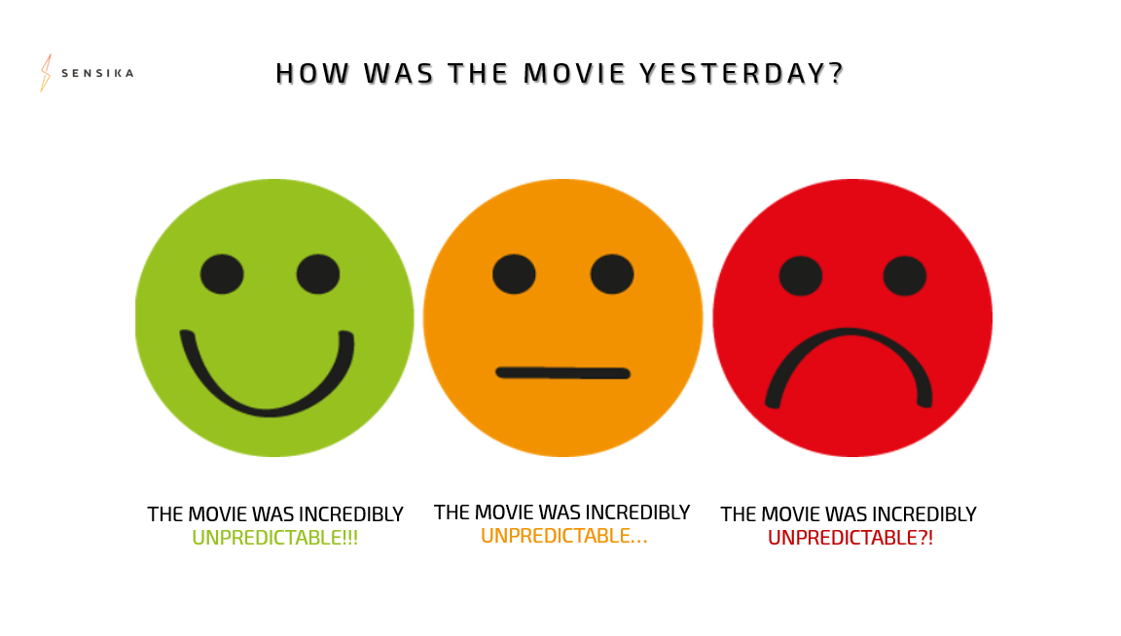
So what is sentiment analysis ?
Sentiment analysis is a process of computationally identifying and categorizing opinions expressed in a piece of text, especially in order to determine whether the writer's attitude towards a particular topic, product, etc. is positive, negative, or neutral.

Slide 4
Use Case
The use case of sentiment analysis is large and has a broad scope. Here in this case the airlines could easily infer answers of various question from the sentiment of tweets.
How the customers are feeling towards their brand?
What issues are the customers facing the most?
What are the average customer sentiments towards their brand?
Are the customers satisfied?
Which class of sentiment is covering their majority segment of
customer?

Slide 5
What are the process involved ?
The process of designing a functional classifier for sentiment analysis can be broken down into five basic categories. They are as follows:
Data Acquisition
Data Cleaning
Data Visualisation
Classification
Web Interface

Slide 6
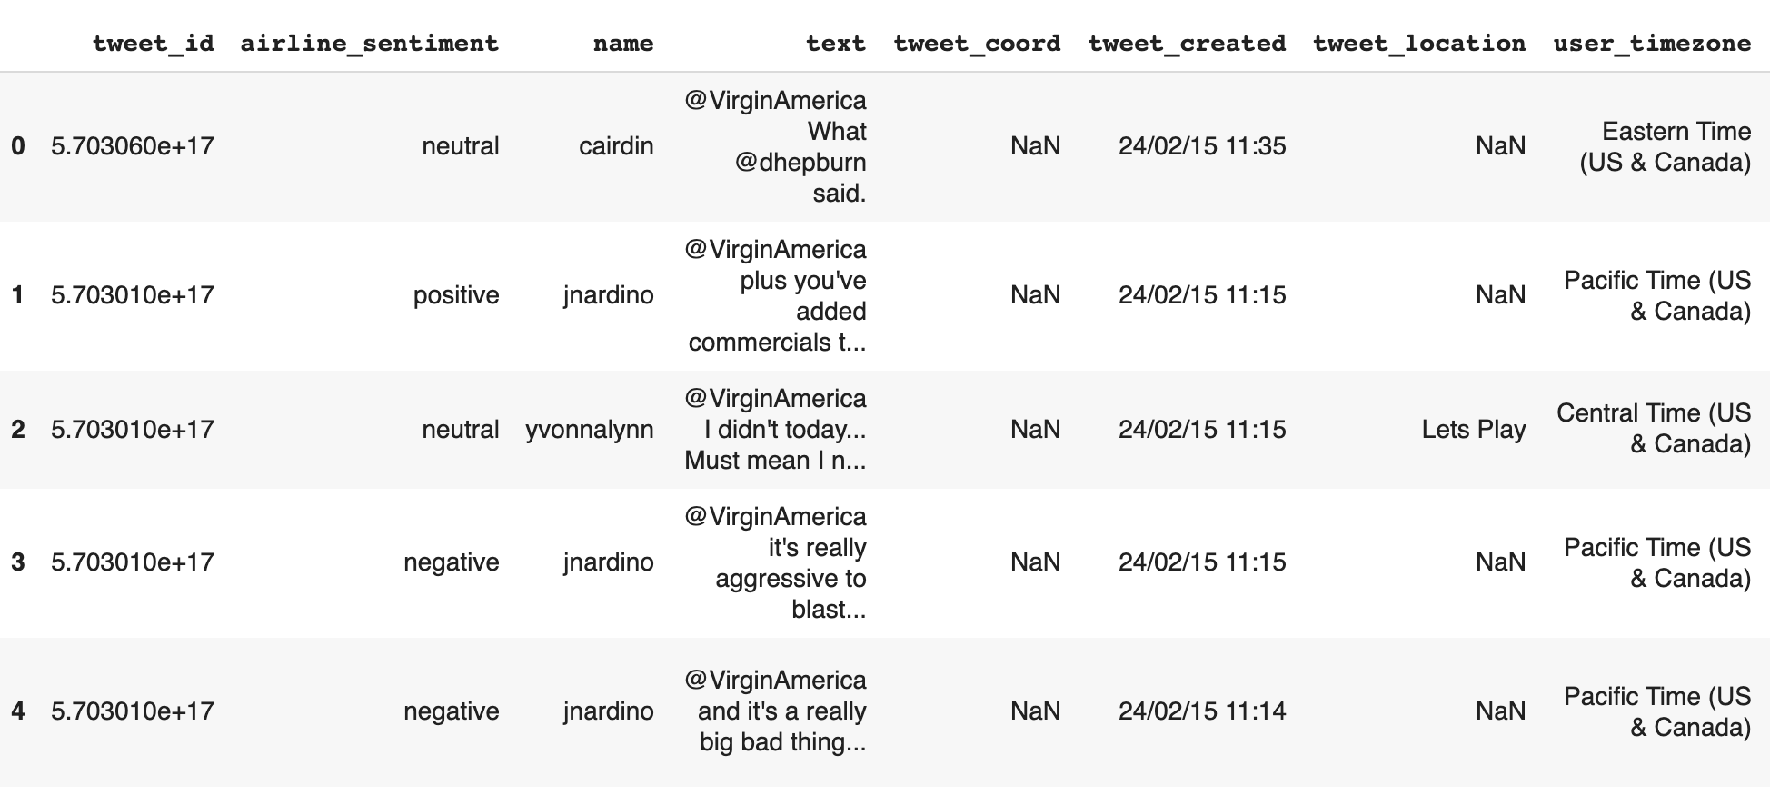
Data Acquisition --> Features Description
There are 8 Columns and 14640 Rows in the provided dataset. The columns are:
Tweet_id
Airline_sentiment
Name
Text
Tweet_coord
Tweet_created
tweet_location
user_timezone

Slide 7
Feature Engineering --> Data Cleaning
Cleaning the text column leaving only relevant information.
Removal of URLs and user references (identified by tokens “http” and “@”)
Removal of Punctuation marks and digits/numerals
Lowercase Conversion of text.
Conversion of emojis to text.

Slide 8
Various NLP techniques applied
After cleaning the text the Nlp techniques applied are:
Tokenization
Stop-words removal
Lemmatization
Parts-of-Speech Tagging

Slide 9
IN summation to data cleaning
So the data cleaning was performed in below given order:
tweet_id and tweet_coord column was dropped o Text column was converted to lowercase
Removal of HTML and URLs from text
@Entities were separated from text and allocated to a new column
#Hashtags were converted to normal text and were also allotted to another column for future analysis of trends
Deconstruction of Text and Emoticons were converted to equivalent emoticon text as they enhanced the value of text.
Punctuation and StopWords Removal
Tokenization and Lemmatization

Slide 10
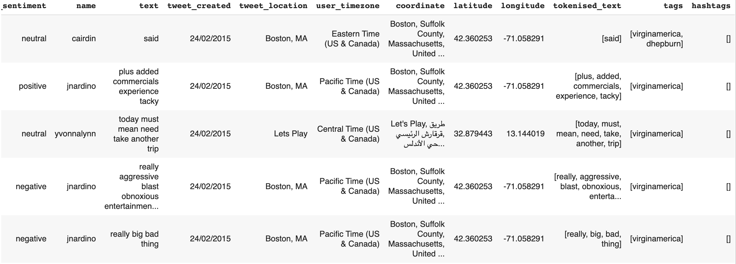
Clean And processed Dataframe

Slide 11
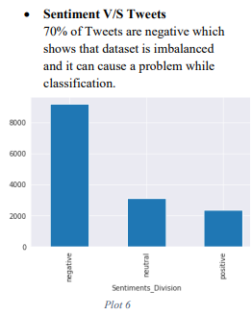
Exploratory Data Analysis
Analyzing the text based on airline sentiment we found that there are more negative tweets than positives.

Slide 12
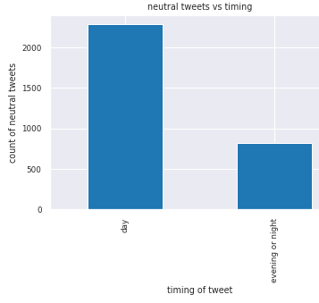
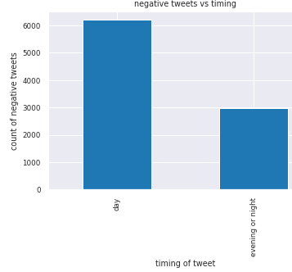
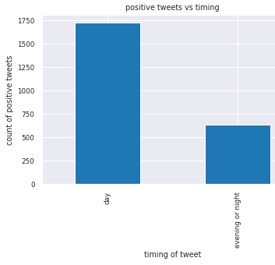
Visualising based on tweet timing
It indicates that regardless of sentiment of tweets, tweets are more frequent in day time rather than evening/night.

Slide 13
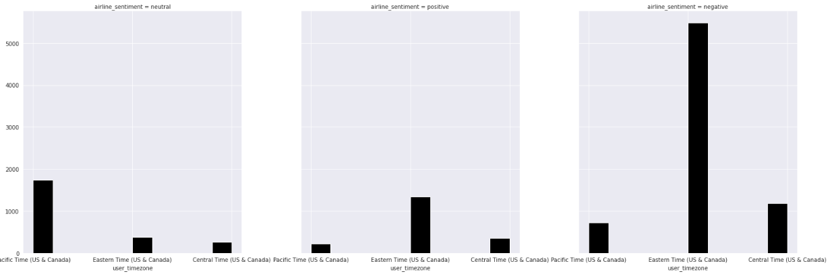
Pacific time zone has highest no. of neutral tweets
Eastern time zone has highest no. of positive as well as negative tweets.

Slide 14
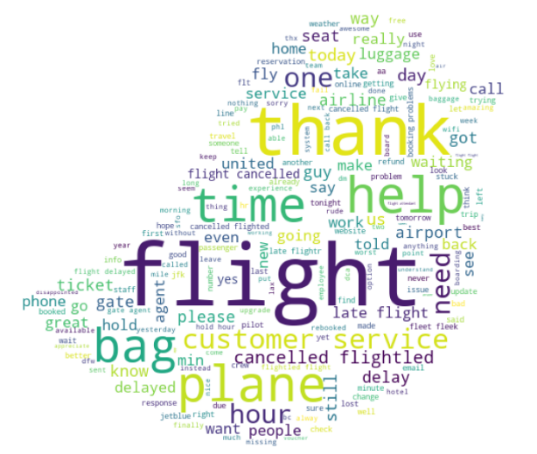
Word cloud
Thank and Flight are the most common words in the whole text column, one being a concrete noun and the other being adjective.
People are using flight with other adjectives such as help, time, cancelled, delay, and other objects related to them as well such as bag, luggage

Slide 15
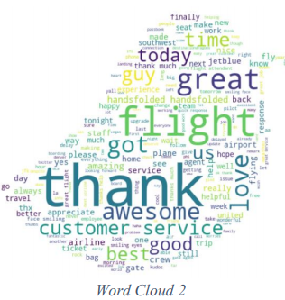
Word cloud of positive labels
The use of word today shows that most users are doing their tweets on the same day of their travel.

Slide 16
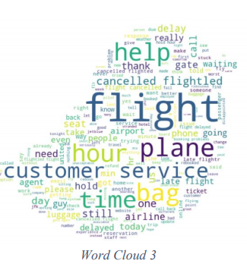
Word cloud of negative labels
Use of the word time is mostly seen in tweets which shows that the majority of negative tweets are for users who are complaining for a delayed flight or so.
The word thank can also be seen but logically word thank is a positive labelled word but presence of this word here signifies that some tweets are sarcasm based negatively labelled
Tweets are also frequently mentioning the word help that means the users are actually relying on the airline’s social media handle for solving their problems. This makes it clear that regardless of company providing a product/service they should be active on their social media handle, also as it provides interaction with their customers.

Slide 17
Converting text to features:
Techniques involved are:-
TFIDF approach
Word2vec approach

Slide 18
Classification of text using ML based Algorithms
The algorithms used are:
Logistic regression classifier
Random Forest Classifier
Support Vector Machine
DecisionTreeClassifier

Slide 19
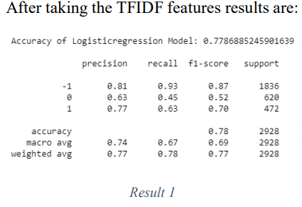
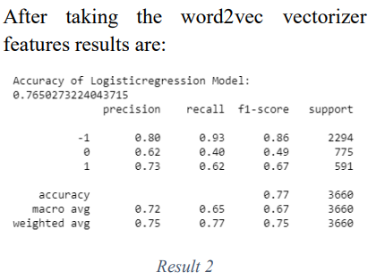
Logistic regression classifier

Slide 20
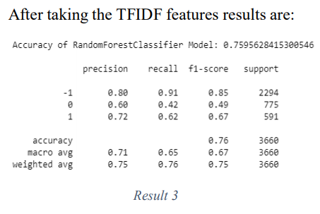
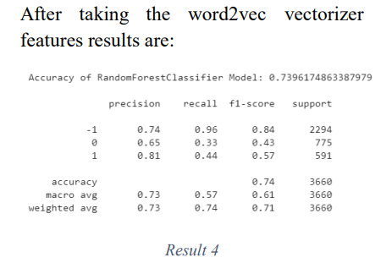
Random Forest Classifier

Slide 21
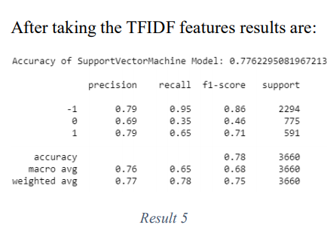
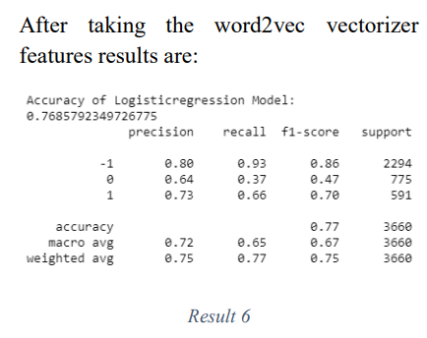
Support Vector Machine

Slide 22
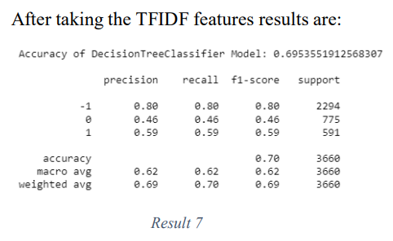
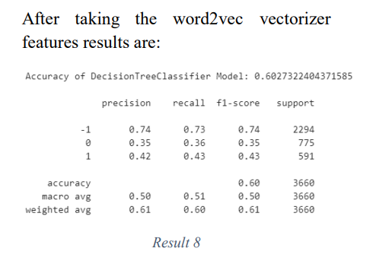
Decision Tree Classifier

Slide 23
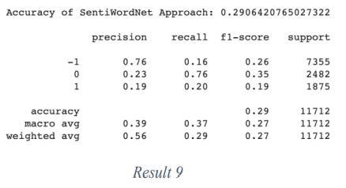
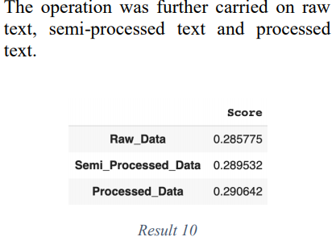
SentiWordNet
IN this the sentences are tokenized and sent to sentiwordnet on word level and the positive and negative score were differenced and the final score was aggregated.

Slide 24
Deep Learning approaches
The various deep learning approaches used for sentiment classification are:
RNN with LSTM
BERT
Using KTRAIN with given database
Using KTRAIN with data balancing
Bert using BertFTModel from Bert Library

Slide 25
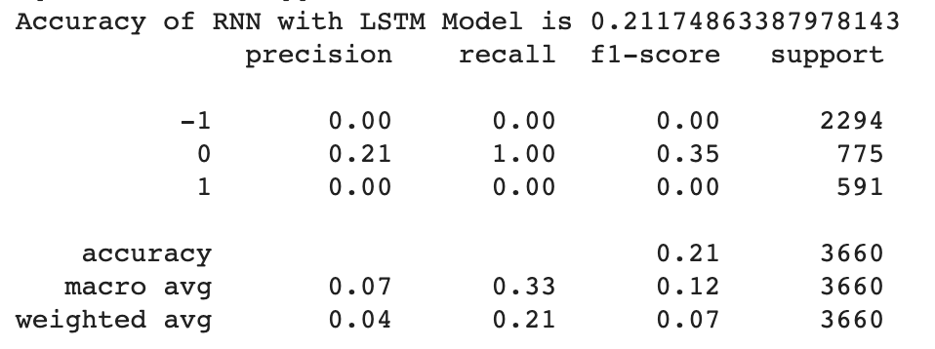
RNN with LSTM
Steps involved in creating a deep learning model for text data are:
One hot encoding the text
Embedding and padding the one hot representation of the text
Deploying the LSTM neural network using Bidirectional Layer from TensorFlow

Slide 26
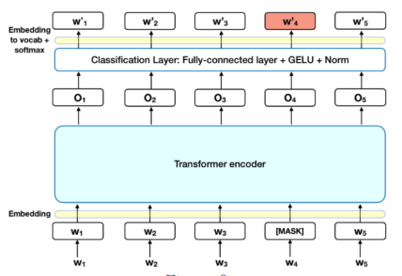
BERT- Bidirectional Encoder Representations from Transformers

Slide 27
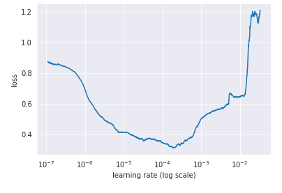
Using KTRAIN-Bert with given database
Loss vs learning rate
Learning Rate 1e-5

Slide 28
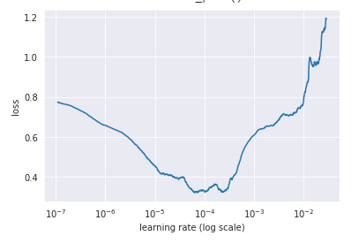
Using KTRAIN-BERT with data balancing
Loss vs Learning rate
Learning Rate – 1e-4

Slide 29
Bert using BertFTModel from Bert Library
Bidirectional Encoder Representations from Transformers (BERT) is a technique for NLP (Natural Language Processing) pre-training developed by Google. BERT was created and published in 2018 by Jacob Devlin and his colleagues from Google. Google is leveraging BERT to better understand user searches.

Slide 30
Bert Library Output

Slide 31
Web Application
To access the tweets sentiment from the trained model Django framework was used to develop a frontend website.
It delivered sentiments of tweets from the model
Hashtags and possible entities were displayed
To compare our predicted sentiment, a commercial sentiment predictor’s api was used
Confidence for each sentiment from each model was displayed
The framework was hosted on Google Colab with some tweaks and workarounds.
The text entered
Clean text
Entities present in the tweet
Screen name(twitter id name)
Possible organization if any.
Hashtags used
Sentiment
Confidence(of sentiment)

Slide 32
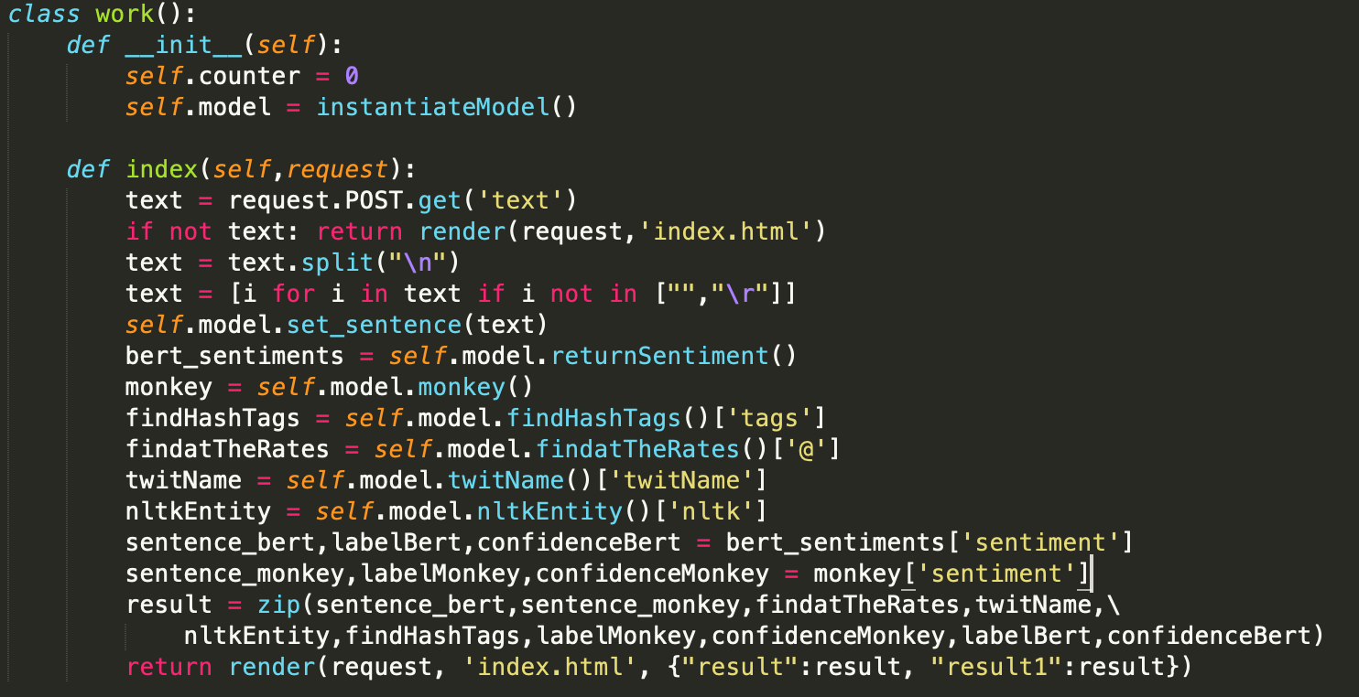
API Backend

Slide 33
API Executed
POST /
Host: bf5bc189106e.ngrok.io/
User-Agent: Mozilla/5.0 (Macintosh; Intel Mac OS X 10.6; rv:2.0b8) Gecko/20100101 Firefox/4.0b8
Connection: Close
Accept: */*
Accept-Encoding: gzip/deflate
Content-Type: xxx/www-form-urlencoded
Content-Length: 50
DNT: 1
Upgrade-Unsecure-Requests: 1
text%3D%40VirginAmerica%20your%20services%20are%20good%26submit%3DSubmit

Slide 34
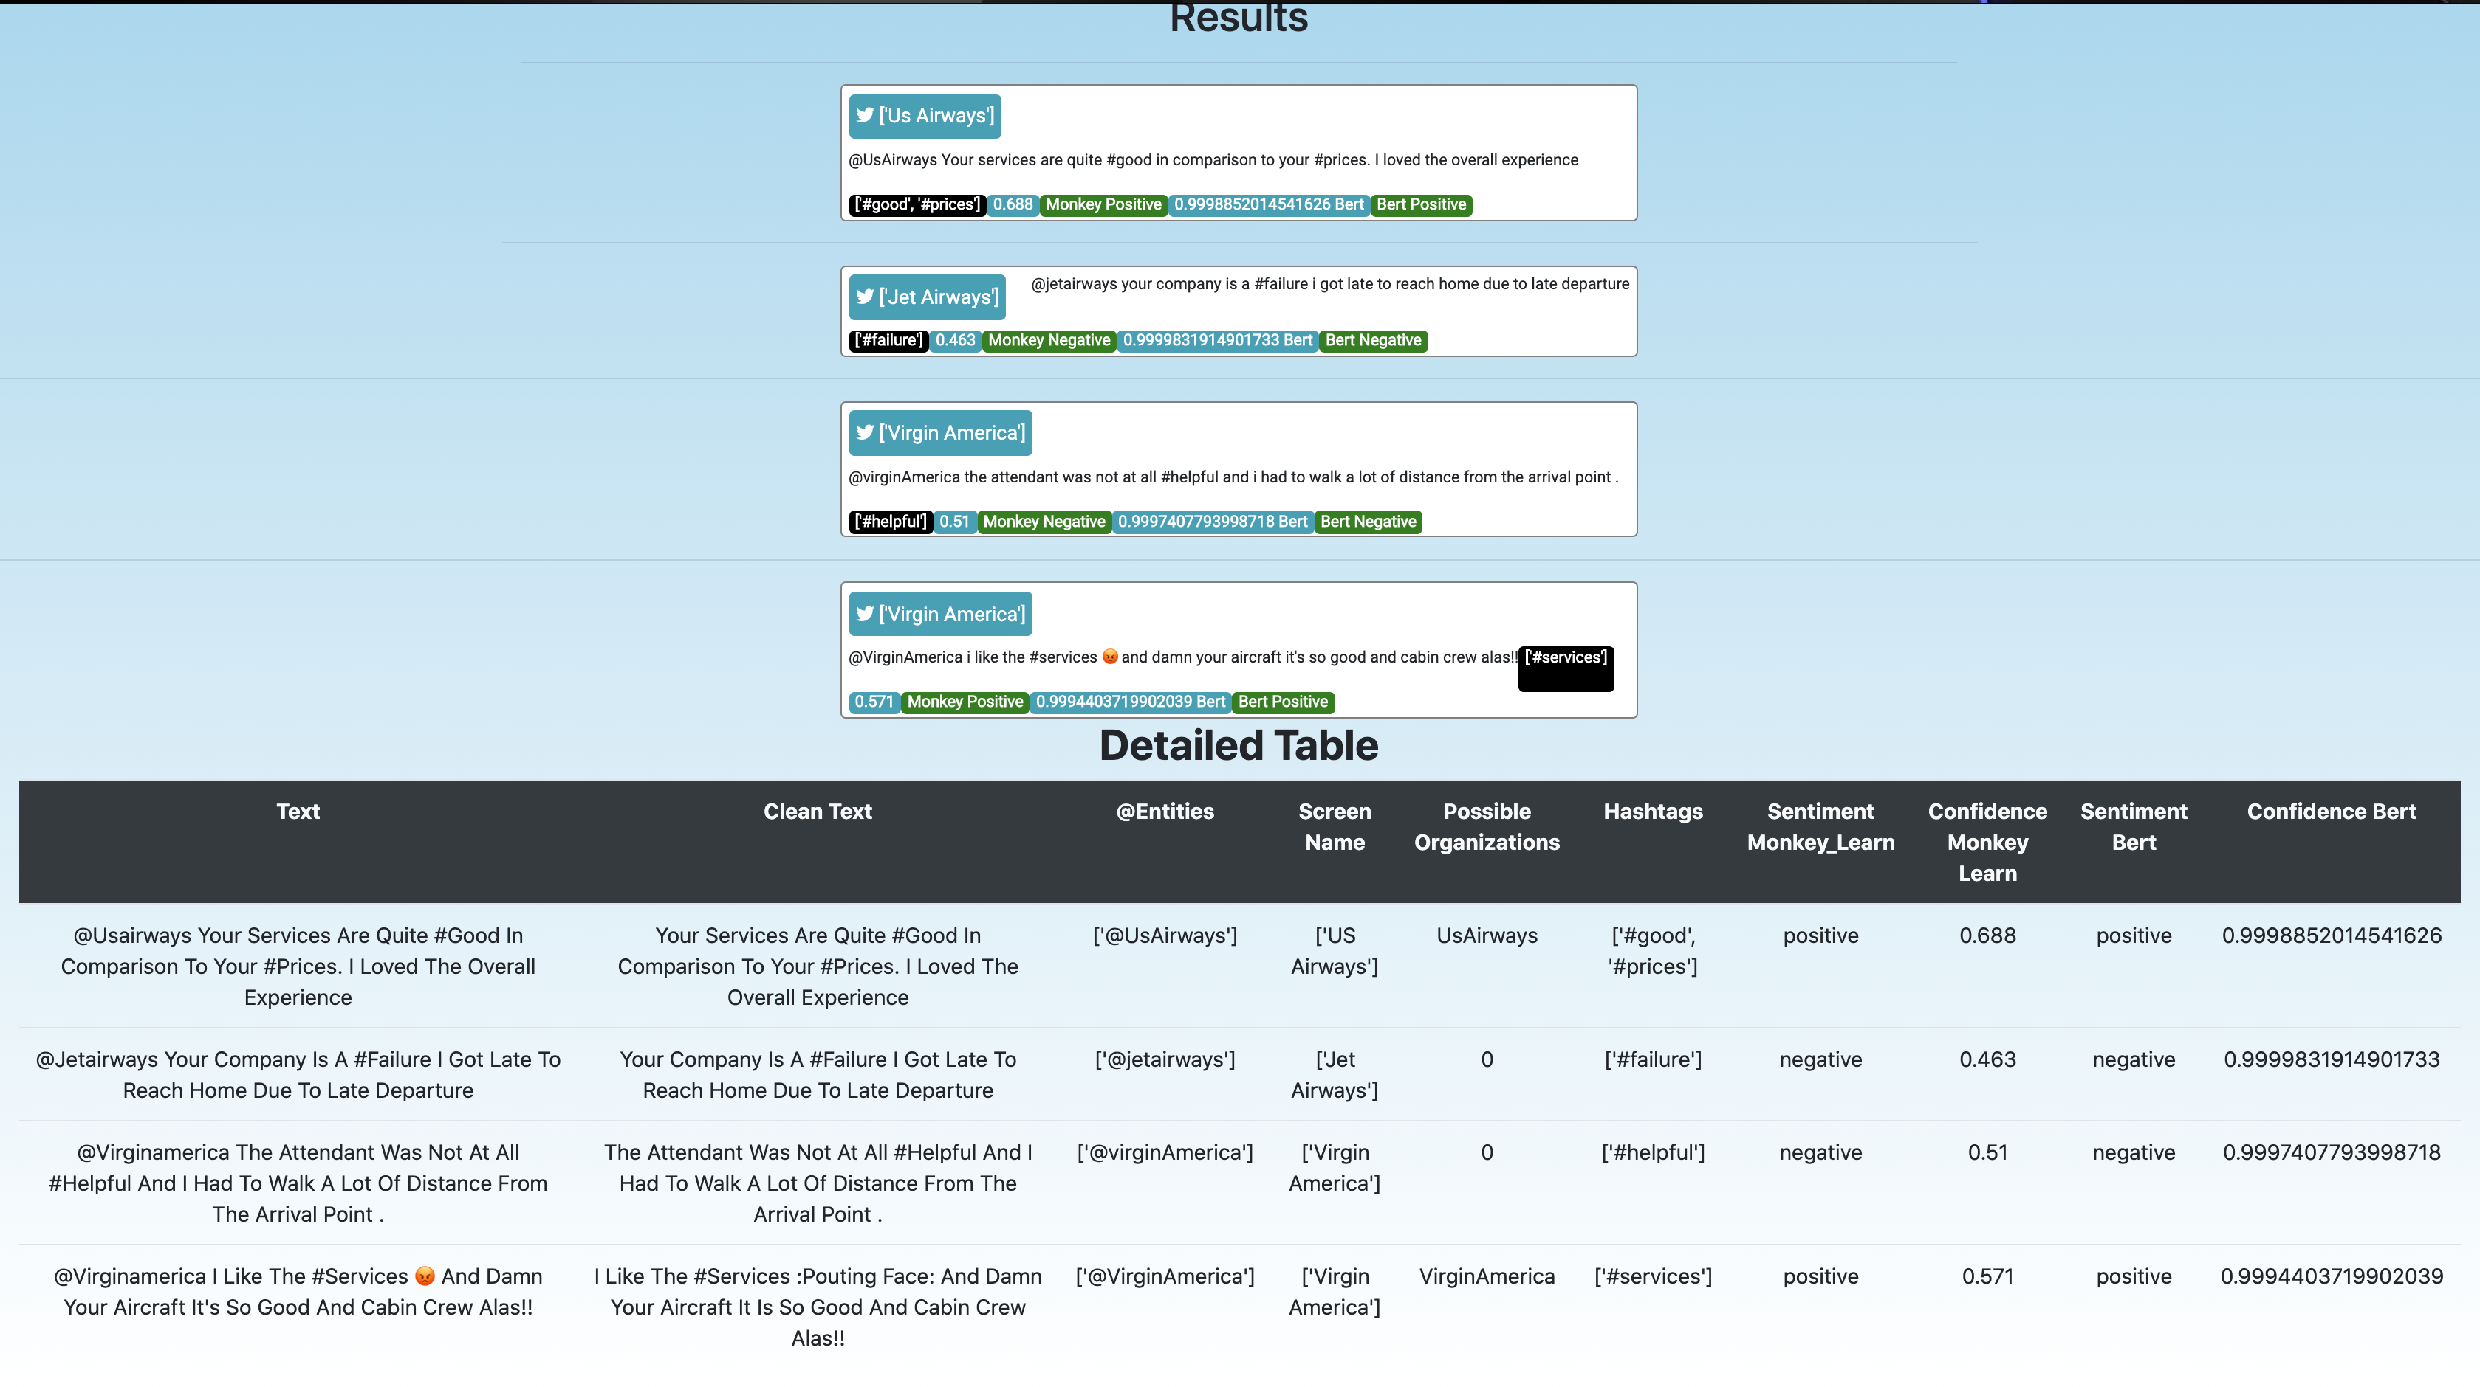

Slide 35
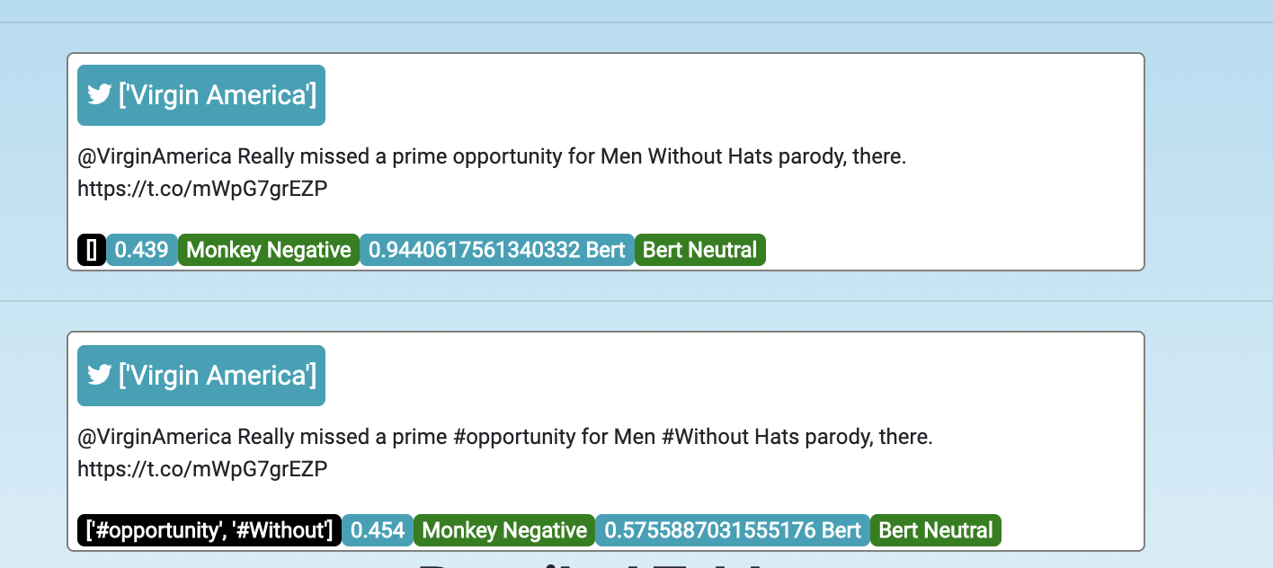
Sentiment Analysed

Slide 36

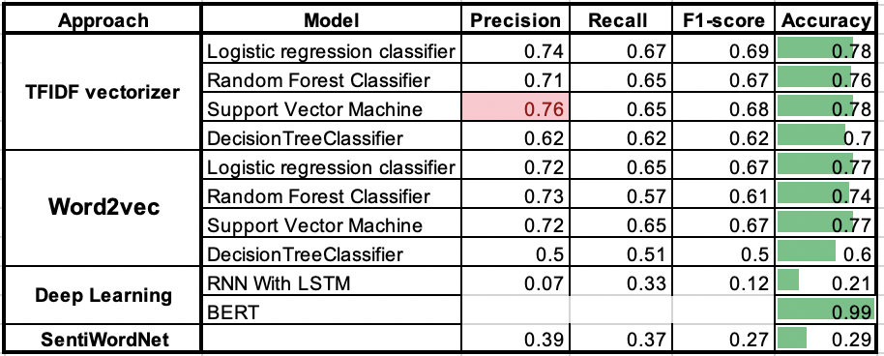
Over the period of time given to this project, several algorithms and models were tried for getting the classification model.
Though Bert Model required more resources than an ordinary model but at the end Bert Model from was found to be more precise.
Bert Model outperformed Ktrain Bert with a substantial increase of 0.35 in accuracy score

Slide 37
Thank you………..

